Slide 1
CRIME + NFL
Team CAKI
(Chad, Alec, Karl, Iris)

Slide 2
MOTIVATION & SUMMARY SLIDE
MOTIVATION: NFL PLAYOFFS have been TOP OF MIND.
FOUND RICH DATASET ABOUT NFL PLAYER ARRESTS OVER THE LAST 20 years and wanted to explore
WHAT DO WE WANT TO EXPLORE
HAVE MORE TEAMS COMMITED MORE CRIMES THAN OTHERS?
WHAT POSSTIONS COMMIT CRIMES?
WHAT KIND OF CRIMES ARE BEING COMMITED?
CRIME OVER TIME?
WHAT IS THE CORRELATION BETWEEN TEAM PERFORMANCE AND TEAM CRIME RATE?

Slide 3
DATA_ALEC
CLEANUP

Slide 4
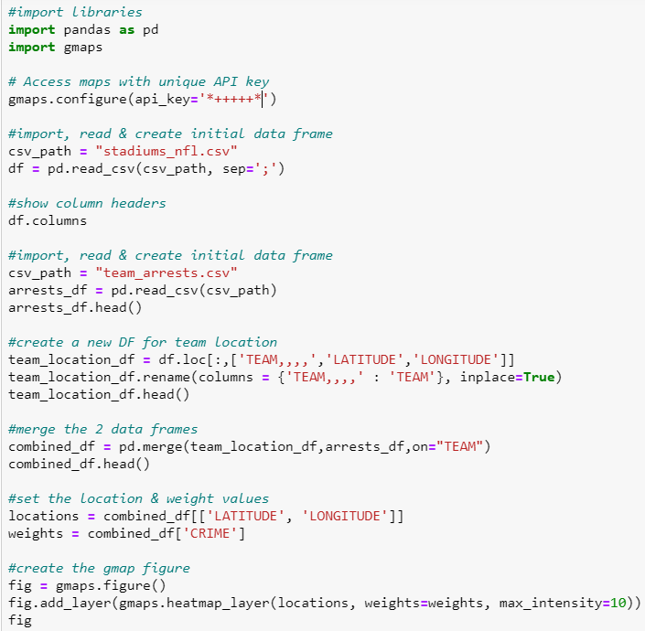
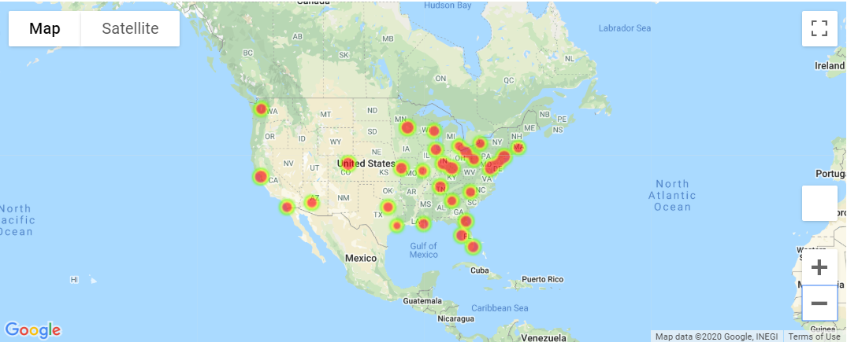
HEAT MAP: TOTAL CRIMES BY TEAM
CODE
VISUALIZATION
ANALYSIS
THE EAST COAST HAS THE MAJORITY OF THE CRIMES
MINNISOTA VIKINGS HAD THE MOST CRIMES OF ANY TEAM
HOUSTON TEXANS HAD THE FEWEST CRIMES OF ANY TEAM

Slide 5
CRIME COUNTS_KARL

Slide 6
SCATTER PLOT _KARL

Slide 7
CRIME OVER TIME_IRIS

Slide 8
POSSITION vs CRIME TYPE_IRIS

Slide 9
HEADER – TOPIC/QUESTION
CODE IMAGE
VISUALIZATION
ANALYSIS

Slide 10
ISSUES & PAIN POINTS
CONTEXT WITH LANGUAGE IN THE DATA
COMBING DATA FRAMES & MERGING ADDITIONAL DATA
DATA MUNGING
SIMPLY CRIME TYPES CATEGORIES
COMPARE CITY CRIME RATE vs TEAM CRIME RATE

